Slide 1
Domain Driven Design
Daniel Połaczański
Szymon Kowal
Tomasz Dubikowski
07.02.2014
Notes:
<numer>

Slide 2
Agenda
• Problems of present-day systems
• What is DDD?
• Ubiquitous language
• Strategic Design
• Building Blocks

Slide 3
Problems of present-day systems?
Features of business software:
Relatively not complicated:
Complicated algorithms are rarity
Simple operations:
shuffling of the data from one heap to another one
continuously changes
Supports running a business

Slide 4
Symptoms of inadequate solution
Big Ball of Mud
Adding new features without attention to model
owing technical debt
Unclean code
Without business rules and processes
Not understandable code
New Requirments vs API
Hard to implement new requirments with current api
Difficult changes
New changes = new problems
After a change nothing works
Entropy always increases...

Slide 5
What to do?
Insanity is doing the same thing, over and over again, but expecting different results.

Slide 6

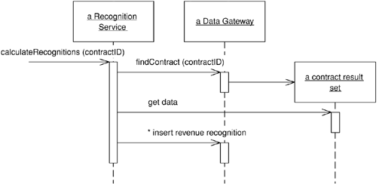
Transaction script – domain logic pattern
Organizes business logic by procedures
Each procedure handles single business case
Adequate to small applications with simple business logic (ex: CRUD)

Slide 7
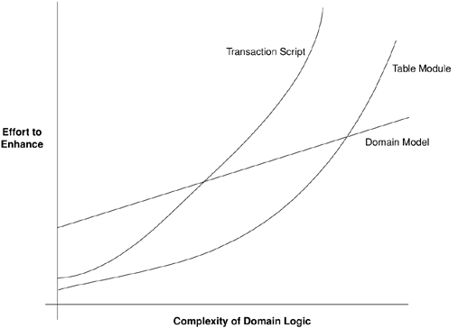
Complexity
- Essential Complexity (unavoidable) - comes from nature of problem
- Accidental Complexity – caused by a suboptimal approach to the problem's resolution
Complexity

Slide 8
What is DDD
from http://domaindrivendesign.org/resources/what_is_ddd:
"Domain-driven design is not a technology or a methodology. It is a way of thinking and a set of priorities, aimed at accelerating software projects that have to deal with complicated domains.".

Slide 9
Model – core of DDD
What model is based on?
- Model is hearth and main business value of system.
- Model represents business domain. Gathers knowledge about rules and dynamics of domain.
- Modelling is the the most difficult task.
- Model represents mutually agreed comprehension by developers, analytics, client
- Model is description and simplification of business reality without useless details
What is not DDD?
Database – doesnt model behaviour, static, doesn't express intentions

Slide 10
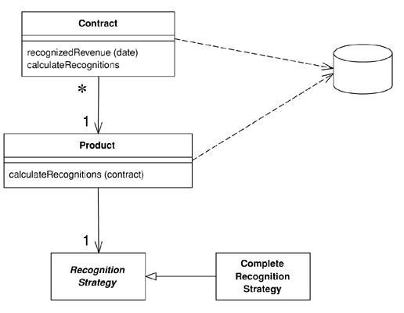
Model - how to express
Draws
Anything understandable by business experts and developers
UML
Draws specific for business domain
Text
People think by “stories”
Analytic documentation is design of business logic as well

Slide 11
What is DDD
There is technically nothing new or revolutionary in DDD, there is only a guide to better way of thinking

